Slide 1
by D Story

Slide 2
Dating
Wrapped

Slide 3
I spent 394,200 minutes being single
Considering I’ve been on some pretty bad dates.

Slide 4
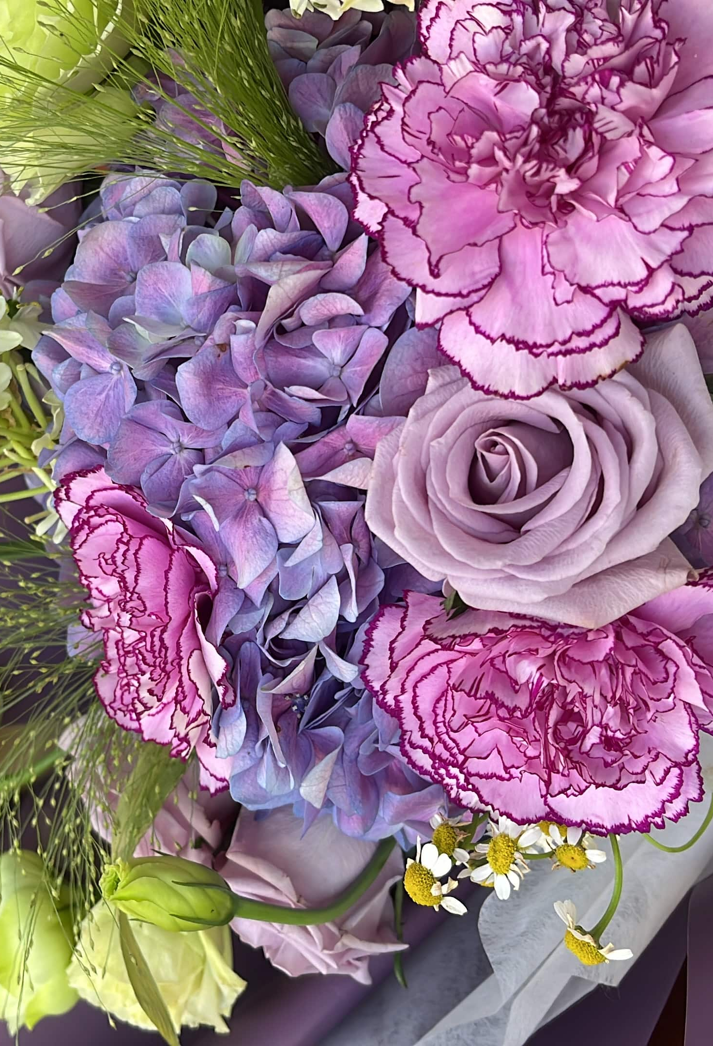
Money spent on dates
First dates
22
$365
Met on dating app
Ghosted
60%
6
Geminis
Made me cry
5
2

Slide 5

2022 Life Update

Slide 6
2022 Life Update

Slide 7
To heal my heartbreak, I ventured into different hobbies
And found myself enjoying being alone again.

Slide 8
1
Skateboarding
2
Formula One
My New Favourite Hobbies
3
Mechanical keyboards
4
Drawing cats
5
Embroidery and tufting

Slide 9
I spent 394,200 minutes being single
Considering I’ve been on some pretty bad dates.

Slide 10
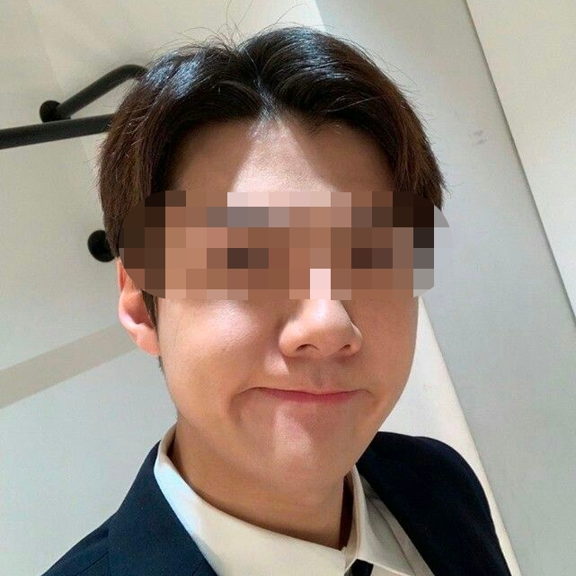
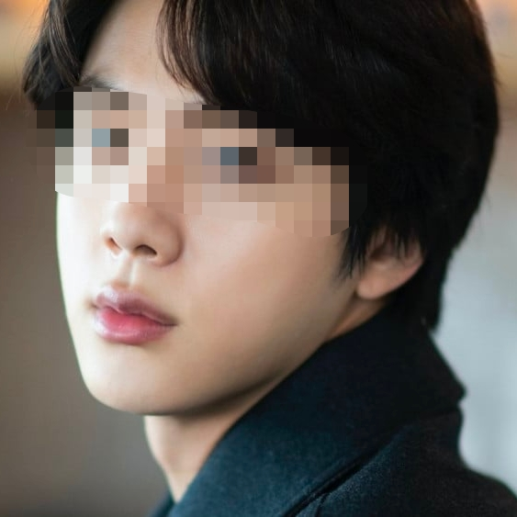

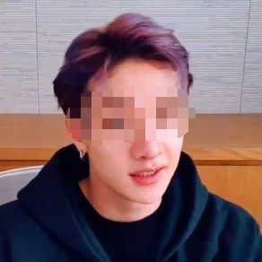

Top 5 worst dates
1
“Hands”
Stalked me for several months after blocking him
2
“NFT guy”
Couldn’t stay off Reddit
3
“Red Bull”
Overuses “>.<“ and “teehee” in texts
4
“Blink”
No sense of humour, not 5’10
5
“Sriracha”
Hot, but has a girlfriend

Slide 11
I talked to 5 guys this year, but I’m in love with just one

Slide 12
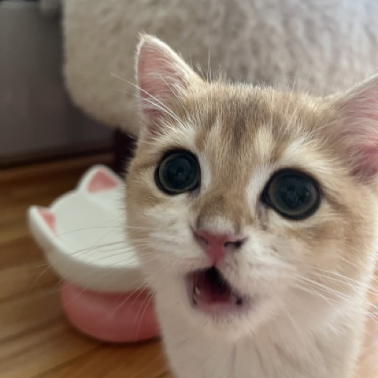
My new kitten “Milk Tea”
We spent 8,640 minutes together across 3 months.

Slide 13
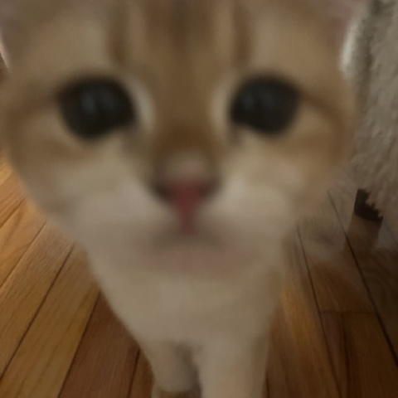
I couldn’t stop thinking about the time he climbed onto my lap.

Slide 14


His Personality Type
ISTJ
Introvert • Sensing • Thinking • Judgement
People with an ISTJ personality type tend to be reserved, practical and quiet. They enjoy order and organization in all areas of their lives.
ISTJs value loyalty in themselves and others and emphasize traditions. While they have a reputation for being blunt, they are also known for being nice, loyal, and responsible.
The Logistician

Slide 15
Say “I get to,” instead of “I have to.”
2022 Lesson #1
I am more in control of my life than I realise.

Slide 16
Practice and express gratitude
2022 Lesson #2
Increases happiness, mood, and helps shift your focus towards the good things in life.

Slide 17
Communicate everything
2022 Lesson #3
No one is a mind reader. Don't assume you know what the other person is thinking/feeling.

Slide 18
















